Slide 1
A classification task in CMR
SCMR Series of Hands-on Workshops on Machine Learning
Olivier Jaubert
Research Fellow in MR Physics and Machine Learning
Centre for Translational Cardiovascular Imaging
UCL Institute of Cardiovascular Science
o.jaubert@ucl.ac.uk
Notes:
Hi everyone.
My name is Olivier, and I’ll be talking about classification, and help you apply your own deep learning based classification model in a cardiac MRI application.

Slide 2

License
This work is licensed under a Creative Commons Attribution 4.0 International License.
You are free to:
Share — Copy and redistribute the material in any medium or format.
Adapt — Remix, transform, and build upon the material for any purpose, even commercially.
Under the following terms:
Attribution — You must give appropriate credit, provide a link to the license, and indicate if changes were made. You may do so in any reasonable manner, but not in any way that suggests the licensor endorses you or your use.
No additional restrictions — You may not apply legal terms or technological measures that legally restrict others from doing anything the license permits.
© 2022 Javier Montalt-Tordera. Some Rights Reserved.

Slide 3
Contents
Basics of classification
Hands-on: Logistic regression
Introduction to classification in medical imaging
Hands-on: Building a classification model
Preparing the data
Hands-on: Preparing the data and running a classification
Notes:
This is the outline,
So we’ll quickly go through some basics of classification, introduce classification in the context of medical imaging through a specific exemple case, and go through a few basic data preparation steps to finally obtain our trained classification model.
For each chapter we will go through some code which you can run on google colab.
The code and data are available on github:
https://colab.research.google.com/github/mrphys/MLinCHD_Workshop/blob/WIP_Workshop2/Workshop2/Exercises.ipynb
We will go through the different steps together at the first hands-on.

Slide 4
Basics of classification
Notes:
So first a bit about the basics of classification

Slide 5
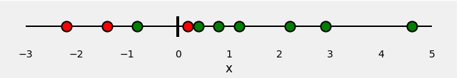
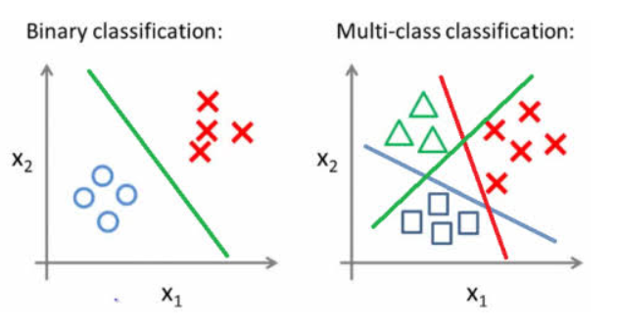
Classifying
Binary classification
Patient / Healthy
Binary classification Multi feature
Multi-class, Multi feature
Disease 1, 2, 3
Notes:
What do we mean by classifying ?
Simply put we aim at differentiating meaningful groups.
It can be Done in a binary way as shown here ->
Here we could imagine differentiating a group of patient from healthy volunteers given a single “feature” x which could correspond to something such as age, myocardial thickness or T1 value.
Similarly information can be combined, and use for exemple age (x1) and myocardial thickness (x2) to determine between healthy volunteers and patients. This is then still a binary classification problem but with multiple input features.
Finally you can have a multi class and multi feature problem where you want to classify different diseases given multiple features.

Slide 6
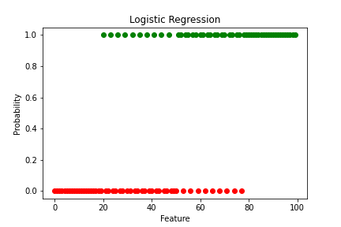
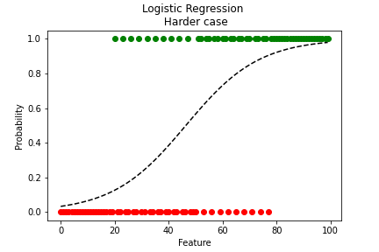
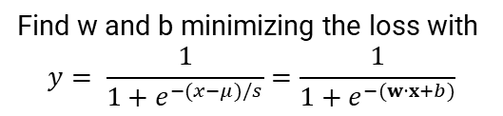
Find w and b minimizing the loss with $y=$ $w⋅x+b$
Logistic Regression
Linear regression
Binary classification
Probability outside of [0, 1]
Not a good probability estimator in case of class imbalance
Probability of a new point
with Feature = 30,50,80 to be of class 1 ?
Find w and b minimizing the loss with
$$y= \frac{1}{1+e^{−(x−μ)/s}}=\frac{1}{1+e^{−(w⋅x+b)}}$$
Logistic regression
Probability inside of [0, 1]
Notes:
How can you formulate the problem ?
Imagine having two groups with the following distribution.
What is the probability that a new point with Feature x belongs to one group or another?
What would you say would be the Probability of a point with Feature = 30 to be of class 1 for exemple ? Pretty low. Or 50? Or 80?
You could do a linear regression as described in the previous lesson. But you can see that it does not really represent a probability. It has values outside of [0 1] and actually is a bad estimator in case of class imbalance.
A more elegant solution and better fit to the problem is a logistic function. As it’s name indicates logistic regression aims at fitting the logistic function which is constrained to [0 1] values and is better suited to binomial fitting (where y can only take two values).

Slide 7
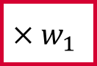
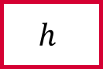
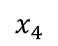

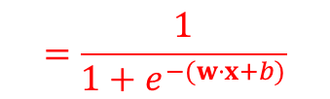
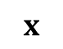
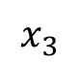
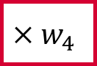
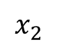


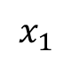

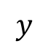
An artificial neuron
inputs
weights
neuron or unit
age
$$x_{1}$$
$$×w_{1}$$
$$×w_{2}$$
output
salt intake
$$x_{2}$$
$$+b$$
$$h$$
$$y$$
High/low blood pressure
body mass index
$$x_{3}$$
$$×w_{3}$$
bias
activation function
alcohol intake
$$x_{4}$$
$$×w_{4}$$
$$x$$
$$w$$
Sigmoid function
$$=\frac{1}{1+e^{−(w⋅x+b)}}$$
$$y=h\left(w⋅x+b\right)$$
Notes:
This is easily implementable via machine learning. A simple logistic regression can be performed as you would do for a linear regression but replacing the last activation function by a sigmoid function
So you would have a vector of inputs (age, salt intake, etc), a set of learnable weights and bias w.x+b to optimally classify the data and the sigmoid activation function providing the output probability (that you have hyper tension for exemple).

Slide 8
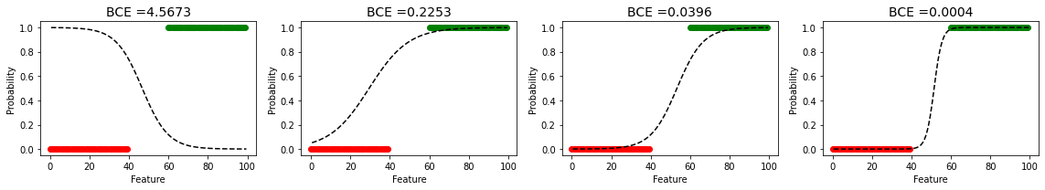
Loss function: Cross entropy
Classification tasks often use the cross entropy loss (i.e.log loss).
Cross-entropy H is a measure of dissimilarity between true labels pi and predicted label qi for each class I (binary cross entropy when you have only 2 classes):
Prediction
Notes:
Additionally to the network architecture a loss function is computed to learn the optimal weights and bias.
Classification tasks often use the cross entropy loss (i.e.log loss).
Without going into the details, cross-entropy gives a measure of dissimilarity between true and predicted labels for any number of classes i.
In the case of two classes it is called binary cross entropy
Just to give a feel for what binary cross entropy measures, we show a few logistic regressions and the corresponding binary cross entropy and we can see that it diminishes with goodness of fit.

Slide 9
Hands-on: Logistic regression using TensorFlow
Notes:
We will now start with our first hands-on session where we will aim at implementing a simple Logistic regression using Tensorflow.
The code and data are available on github
Which you can download at https://github.com/mrphys/MLinCHD_Workshop (put in the chat box)
Let’s upload the MLinCHD_Workshop/Workshop2/Exercises.ipynb in google Colab
Try to run the first cell when you are done and let me know if anyone is having an issue.

Slide 10
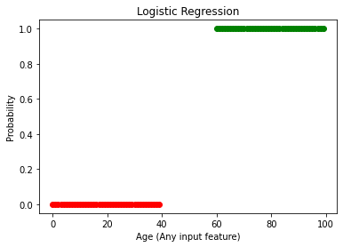
#Logistic regression
import numpy as np
import tensorflow as tf
import matplotlib.pyplot as plt
%matplotlib inline
x=np.concatenate((np.arange(0,40),np.arange(60,100)))
y=np.zeros(x.shape)
y[x.shape[0]//2:]=1
plt.figure()
plt.plot(x[y==0],y[y==0],'ro')
plt.plot(x[y>0],y[y>0],'go')
plt.xlabel(‘Age (Any input feature)')
plt.ylabel('Probability')
plt.title('Logistic Regression')
Import libraries
Create data
Plot data
Notes:
The first piece of code I shown here.
From the last session you should be familiar with some basics of python
As usual you can import your favorite libraries at the beginning of your file.
Here we import tensorflow, numpy and matplotlib for plotting.
We then generate our very simple distribution of points with values 0 or 1.
In this case the feature is perfectly separating the 2 classes it is of course not always that clear cut !
We plot class 1 in green and 0 in red (this will be our training dataset) and decorate the graph with some axis names and title.

Slide 11
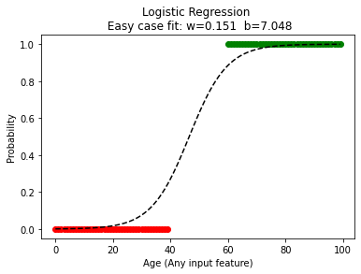



Define model
model = tf.keras.Sequential()
number_of_classes = 1
number_of_features = 1
model.add(tf.keras.layers.Dense(number_of_classes,activation = 'sigmoid',input_dim = number_of_features))
opt = tf.keras.optimizers.Adam(learning_rate=0.01)
loss= 'binary_crossentropy'
model.compile(optimizer=opt, loss=loss)
history= model.fit(x, y, epochs=1000,batch_size=5)
inputs
weights
neuron or unit
age
$$x_{1}$$
$$×w_{1}$$
$$+b$$
Sigmoid function
Probability
(you are a patient)
bias
activation function
Fit the model using a loss and optimizer
Notes:
A very simple model as described previously will be taking one input, apply 1 weight + 1 bias (2 learnable parameters), apply the sigmoid function and outputting 1 probability.
The model is then compiled with a loss, here the binary cross entropy. And an optimizer which if you remember from the previous lesson will choose how to update the learnable parameters given the loss.
Model.fit is then called to fit the model to the data to minimize the loss. This is performed over a certain number of mini batches and epochs.
This gives us the following function yhat= h(wx+b)
The same can be performed given a less obvious distribution

Slide 12
Introduction to classification in medical imaging
Notes:
So far we’ve been handling abstract features.
And now we’re going to have a look and see how we can apply this in the context of images.

Slide 13
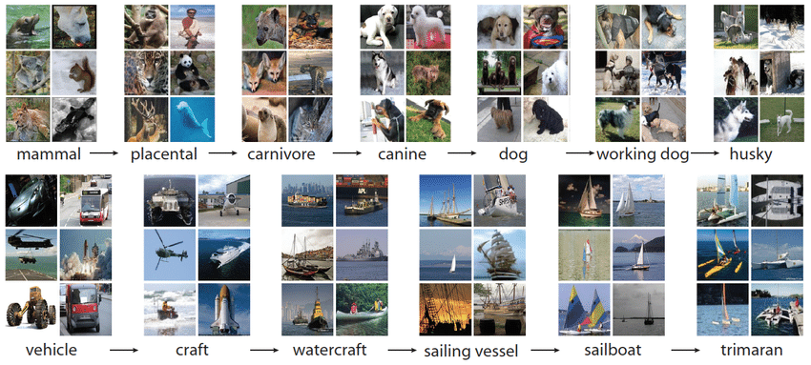
Fashion MNIST
ImageNet
T-shirt/top
T-shirt/top
dress
sandal
ankle boot
sneaker
trouser
coat
bag
Notes:
Why would we want to apply classification to images. The idea is to extract structured information from images.
Many applications have risen autonomous driving, facial recognition and more of interest to us, medical image analysis.
Here we show classical datasets used for classification challenges in natural images.
Fashion MNIST, which you’ve seen before aims at labelling fashion items.
And the famous ImageNet dataset with over 14 million annotated images.
These are largely used by the machine learning community to develop higher performance algorithm. They are very large and publicly available.

Slide 14
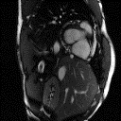
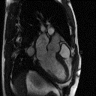
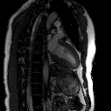

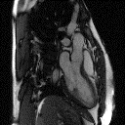
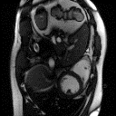
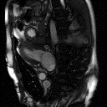
UK Biobank
Datasets for Cardiac MRI
OCMR
Ohio State Cardiac MRI Raw Data (OCMR) was accessed on 01/06/2022
from https://registry.opendata.aws/ocmr_data.
Notes:
In medical imaging although of lesser sizes and less publicly available, a great effort is being made to obtain curated image datasets. For exemple, UK Biobank is a large dataset including more than 7000 cardiac MRI images with a lot of associated health data.
In the following exercise we will actually use the OCMR dataset from the Ohio State university which allowed us to share the images during this workshop. It consists of 183 different slices of Cine cardiac MRI in different orientations (124 SAX, 42 non SAX) and we will be working on a subset of 74 slices.

Slide 15
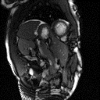
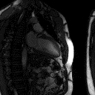
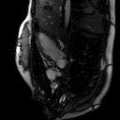
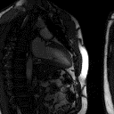
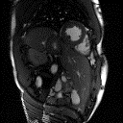
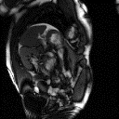
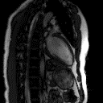
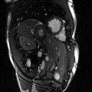
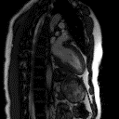
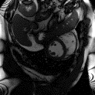
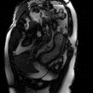
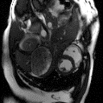
Classifying orientation
Notes:
As an exemple task for this workshop on image classification we propose to classify the images’ orientation.
Imagine you have a huge dataset of images which you want to label according to their orientation in order to extract only short axis images.
We can see the huge variability in terms of anatomies, contrast, etc.

Slide 16
Image classification
Feature extraction via CNN
Feature Combination via Dense layer
Logistic regression
Features ?
learnt features
Rules ?
Probability it is a SAX
Notes:
Now instead of independent abstract features you have an image as input.
Which is effectively a very large number of input features with some structure/correlation in space.
Traditionally you would code and extract expert designed features and classify the images according to these features.
The question is then which features and how do you extract them from the image ?
It turns out that classifying through man-made features is harduous, shows poor performance and is not very generalizable to different problems. For instance recognizing the difference between a cat and a plane might have very different rules.
Yet we as humans find this task very easy. After seeing only a few exemples we can recognize a short axis from long axis.
Machine learning tools can effectively be deployed to learn how to extract relevant features to a task (and Convolution Neural Networks (CNN) are especially used for image based applications) often followed by Dense layers to combine these learnt features together to make the proper decision and Logistic regression to output a probability.

Slide 17
Machine learning for image classification
Machine Learning
Answers
Rules
Data
Data
Answers or labels
SAX
LAX
SAX
LAX
Notes:
And so for many problems it is much easier and more performant to provide Data and Answers and then use machine learning tools to create a classifier rather than handcrafting it.
And so for our application we will have a dataset with Images and SAX or non SAX labels and we will try to create a classifier enabling us to identify short axis images from a larger dataset using a CNN.

Slide 18
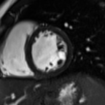
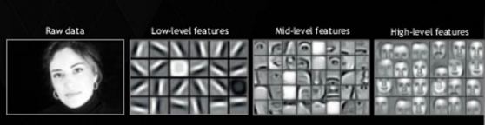
Building the model
higher resolution
Feature extraction
higher level semantics
4 feature maps or channels
8 feature maps
Dense layers
sigmoid activation
conv
pool
conv
pool
flatten
probability
Notes:
Here’s a quite conventional architecture to do so. Feature extraction is performed through multiple layers of successive convolutions, activations and pooling.
These are particularly effective in imaging to condense information into fewer features.
It goes from higher resolution features to higher level semantics. And I’ve put this example of what we mean by low level vs high level features.
The reduced number of higher level semantics features are then used as input to a Dense layer to combine the information.
A sigmoid output activation is then used to transform the output into a probability.
Trainable parameters are learned through back-propagation to minimize the loss function (for exemple the binary cross entropy).

Slide 19
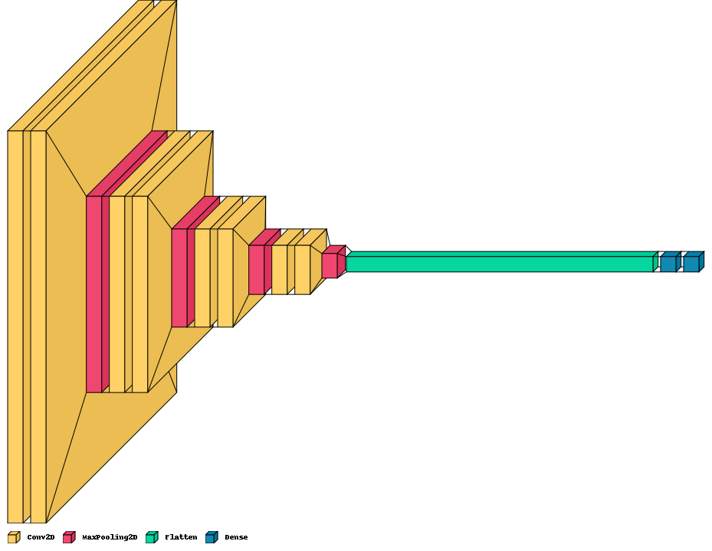
Building the model
Feature extraction
higher resolution
higher level semantics
sigmoid activation
probability
Notes:
Graphically it can be plotted this way, where you can see the contracting path of feature reduction and the dense activation combining the flattened features into a probability.

Slide 20
Hands-on: A simple classification model
Notes:
Let’s try to create the model we described using tensorflow !

Slide 21
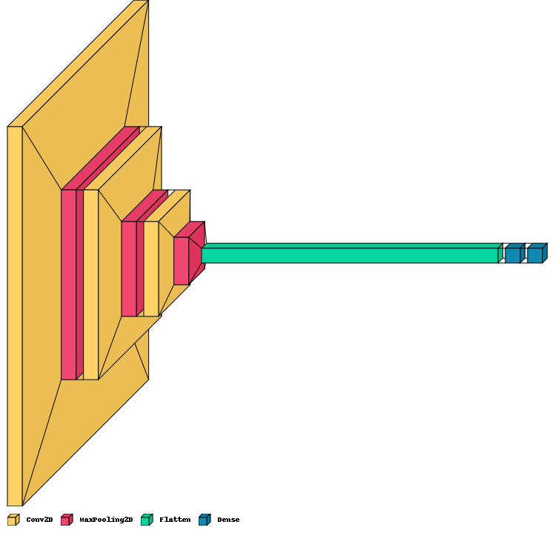
Creating a Classification model
# Shape of the data
input_shape = (128, 128, 1) model = tf.keras.models.Sequential()
#CNN feature extraction #Layer 1
model.add(tf.keras.layers.Conv2D(8, kernel_size=(3, 3), padding='same’,
activation='relu', input_shape=input_shape))
model.add(tf.keras.layers.MaxPooling2D(pool_size=(2, 2)))
#Layer 2
model.add(tf.keras.layers.Conv2D(16, kernel_size=(3, 3), padding='same', activation='relu'))
model.add(tf.keras.layers.MaxPooling2D(pool_size=(2, 2)))
#Layer 3
model.add(tf.keras.layers.Conv2D(32, kernel_size=(3, 3), padding='same', activation='relu'))
model.add(tf.keras.layers.MaxPooling2D(pool_size=(2, 2)))
# Dense Layer # Reduce to 1 dimension for classification
model.add(tf.keras.layers.Flatten())
# Fully connected to combine all features
model.add(tf.keras.layers.Dense(64, activation='relu'))
# Logistic Regression
model.add(tf.keras.layers.Dense(1, activation='sigmoid'))
Notes:
First you import the libraries
We will create a simple model together
First we crerate an empty model:
Model which is a tf.keras.models.Sequential() object
Which we can fill in by sequentially adding layers one by one.
AS described earlier we add 3 layers of:
Conv2D where the number of feature maps is doubled at every layer.
and max pooling where the resolution is halved in each spatial dimension.
After a few layers we obtain the higher level semantics features and input them in a Dense layer to combine them.
Finally we print the model summary
and return the model.

Slide 22
# Compile the model
loss_function=tf.keras.losses.binary_crossentropy
optimizer = tf.keras.optimizers.Adam(0.001)
model.compile(loss=loss_function, optimizer=optimizer, metrics=['accuracy’])
# Split data, define batches, number of epochs etc,
verbosity = 1
no_epochs=10
batch_size=10
# Fit model to data -> No data yet !
model.fit(train_data, train_labels, validation_data=(val_data,val_labels),
batch_size=batch_size, epochs=no_epochs, verbose=verbosity, shuffle=True)
model
+ loss
+ optimizer
+ metrics
Notes:
Finally to train that model, you need to attach to it a loss and an optimizer here the binary cross entropy. You can additionally add some metrics which you desire to monitor here we add the accuracy (this has no influence on the training but enables to track some kind of performance throughout the training).
You define a batch size, no of epochs and finally you can fit your model ! Except that no, you ‘re missing the most important part ! The data !

Slide 23
Preparing the data
Notes:
So in this section we will go over how from a set of DICOM files we can obtain ML ready data.

Slide 24
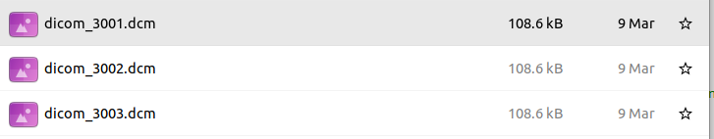
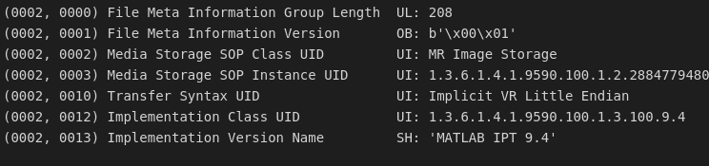
DICOM data
Unorganised Dataset
4106 DICOM files
DICOM
- Header
PatientID - Separate the different patients
SeriesNumber - Order slices from the same patient
InstanceNumber - Order time points for each series/slice
ProtocolName - Label for the data type e.g. SAX, LAX or 4Ch
- Image
Organised Dataset
(1 timepoint, 1 slice per stack)
74 DICOM images
32 SAX, 42 non SAX
Notes:
A crucial step in Machine learning is obviously the data used.
From a list of DICOM files you need to prepare the data to obtain data digestible for TensorFlow or whichever machine learning software you desire to use.
A DICOM consists of :
a header with information relative to the patient and imaging.
And the image.
Here we use 4 header informations to organize the data.
PatientID - Separate the different patients
SeriesNumber - Order slices from the same patient
InstanceNumber - Order time points for each series/slice
ProtocolName - Label for the data type e.g. SAX, LAX or 4Ch
To finally obtain an organized Dataset.

Slide 25
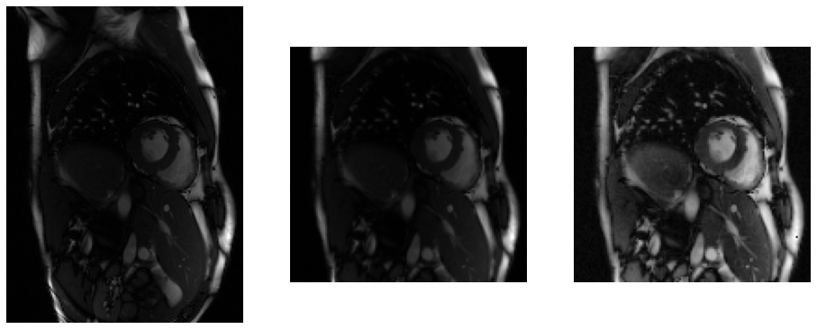

Preprocessing the data
Image: float32 [0 1]
Input size 128x128
Image: int32
Contrast Normalization
DICOM
Database
Label: text
‘SAX’
Label: hot encoded
1
Label: hot encoded
1
Notes:
Further preprocessing is often necessary.
In our exemple, we
Convert the data to normalized float values, crop the images to (128,128). An additional step of image contrast normalization was also used image per image.
- Create or convert the labels

Slide 26
Splitting the data
Organised Dataset
All data
Training
60 %
Validation
20 %
Test
20 %
Training
SAX
Training
Non SAX
Val
SAX
Val
Non SAX
Test
SAX
Test
Non SAX
Notes:
Once the dataset is organised, we split the data into a training set, Validation set and Test Set.
The dataset is split to provide a somehow balanced numbers of SAX and non SAX,
The important is to have enough exemples of each case to learn the task and evaluate the network.

Slide 27
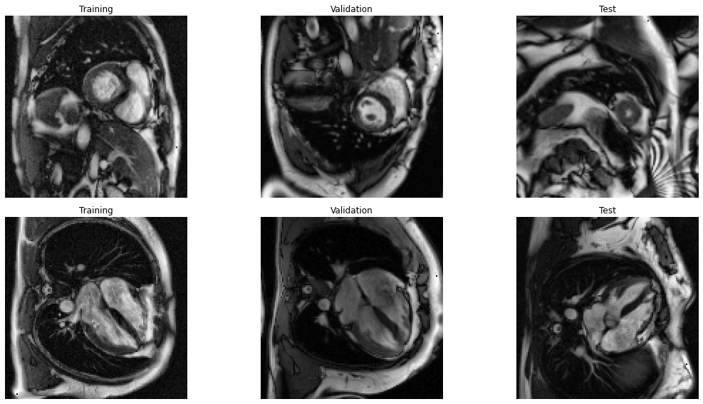
Vizualizing the data
Don’t forget to look at the images!
Python array:
train_data: train_data.shape -> (nsamples, 128, 128, 1)
Access sample #0 :
plt.imshow(train_data[0,:,:,0] ,cmap=‘gray’)
Access last sample (#-1):
plt.imshow(train_data[-1,:,:,0], cmap=‘gray’)
Notes:
It’s important to have a look at the data. At least a few samples to check they are correctly labelled/normalized etc.
Otherwise you can have some annoying surprises and sometimes hard to diagnose errors at the end.
In it’s final form the data is stored as a Ndimensional array of size (nsamples, 128, 128, 1).
You can plot them using the matplotlib imshow function and check the data makes sense !
Ok now we have all the tools to prepare our OCMR data and run the model !

Slide 28
Hands on: Preparing the data and running the model

Slide 29
Downloading the data to the downloadpath folder
images_url="https://media.githubusercontent.com/media/mrphys/MLinCHD_Workshop/WIP_Workshop2/Workshop2/data/DICOMfiles.zip"
!wget {images_url} -P {downloadpath}
tmp_path=downloadpath+'/DICOMfiles.zip'
image_path=downloadpath+'/Workshop/'
!unzip {tmp_path} -d {image_path}
image_path=downloadpath+'/Workshop/DICOMfiles/'
Downloads the data from github
Decompress the data into specified folder
Notes:
Let’s download the data from github onto the google colab.

Slide 30
Reading and organizing the data
imageSize = 128
#Load Short Axis into SAXelements
ShortAxisfolder=image_path+'/ShortAxis/'
SAXelements=np.zeros((len(os.listdir(ShortAxisfolder)),imageSize,imageSize,1))
for ii,file in enumerate(np.sort(os.listdir(ShortAxisfolder))):
file_path = ShortAxisfolder+file
# read file
ds = dicom.dcmread(file_path)
# process image image = ds.pixel_array
image_preproc=image_preprocessing(image)
# store in SAXelements
SAXelements[ii,:,:,:]=image_preproc
#Load Non Short Axis into nonSAXelements
…
#Create labels
SAXLabels=np.ones((SAXelements.shape[0],1))
nonSAXLabels=np.zeros((nonSAXelements.shape[0],1))
For all files in Short axis folder
Read Dicom
Get raw image
Run preprocessing function
Store and go to the next
Create Labels
Notes:
We have a long list of files which we are going to read, preprocess the data and organize it into an ordered dictionary.

Slide 31
Splitting the dataset
# Split the dataset into training, validation and test set
train_perc=60/100
val_perc=20/100
nTrain_SAX=int(train_perc*SAXelements.shape[0]);nTrain_nonSAX=int(train_perc*nonSAXelements.shape[0])
nVal_SAX=int((train_perc+val_perc)*SAXelements.shape[0]);nVal_nonSAX=int((train_perc+val_perc)*nonSAXelements.shape[0]);
# Train Data
train_data=np.concatenate((SAXelements[:nTrain_SAX,:,:,:],nonSAXelements[:nTrain_nonSAX,:,:,:]),axis=0)
train_labels=np.concatenate((SAXLabels[:nTrain_SAX,:],nonSAXLabels[:nTrain_nonSAX,:]),axis=0)
# Do the same for validation and test
#Plot Images:
Dataset: SAX 32 nonSAX 42 Total 74
Train: SAX 19 nonSAX 25 Total 44
Validation: SAX 6 nonSAX 8 Total 14
Test: SAX 7 nonSAX 9 Total 16
Formatted Training Image Sets Shapes :
train_data.shape -> (44, 128, 128, 1) )
Formatted Training Label Sets Shapes:
train_labels.shape -> (44, 1)
Notes:
Finally last steps before using the data :
Splitting the dataset into Train, Validation and Test dataset -> Here we split 60% train, 20 % validation and rest is test data and we pay particular attention to have a similar split between SAX and non SAX data to have a reasonable amount of exemples of each case for training, validation and test sets.
The final format of the data is 3 datasets of images and of labels. For exemple for the train_data the shape is 4-dimensional with dimensions of (44,128,128,1).
As previously explained, we might want to have a look at the data before fitting the model.

Slide 32
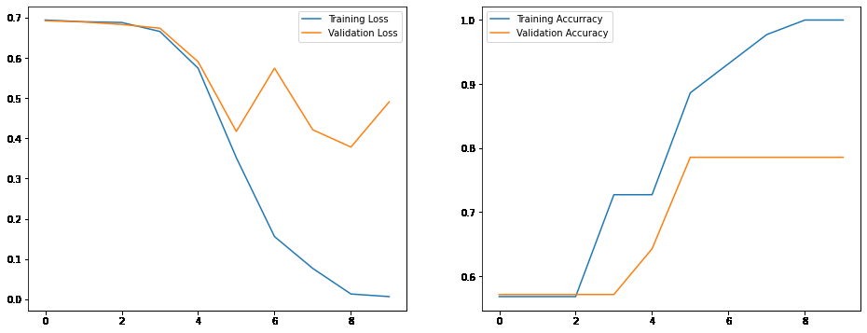
Training the model
model=create_base_model(train_data)
# Compile the model
loss_function=tf.keras.losses.binary_crossentropy
learning_rate=0.0001
optimizer = tf.keras.optimizers.Adam(learning_rate)
model.compile(loss=loss_function, optimizer=optimizer, metrics=['accuracy’])
# Define batches, number of epochs etc,
verbosity = 1; no_epochs=10; batch_size=1
# Fit model to data
history = model.fit(train_data, train_labels, validation_data=(val_data,val_labels), batch_size=batch_size,epochs=no_epochs,verbose=verbosity,
shuffle=True)
loss: 0.0066
accuracy: 1.0000
val_loss: 0.4610
val_accuracy: 0.7857
Notes:
You now have the data I use a small function create_base_model which creates a similar but bigger model than previously seen and we are ready.
The model is depicted in the figure on the right.
We can fit that model to the data using the .fit function.
This shouldn’t take too long -> And then you can see what happened during the training using the history output
Let’s plot the loss and metrics to see. -> We can see the training worked minimizing the loss on the training data, There is a discrepancy between the training and validation loss and we will talk about that in the next session but we call this overfitting.
Similarly for the accuracy -> we obtain perfect accuracy for training and a lower but still decent validation accuracy of around 78%.

Slide 33
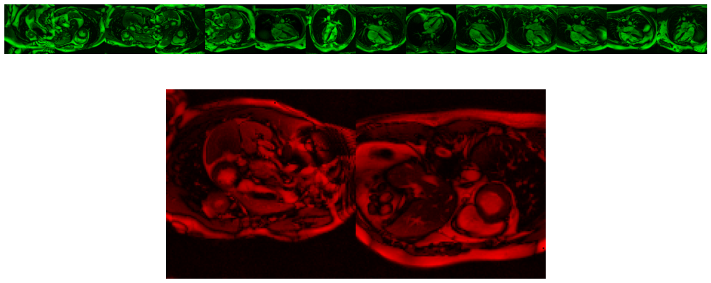
Test set results
#Plot Test set (green correct, red incorrect)
## Evaluate the model on the test set
testeval = model.evaluate(test_data,test_labels); results = model.predict(test_data)
1/1 [==============================] - 0s 16ms/step - loss: 0.2206 - accuracy: 0.8750
Notes:
Once satisfied with the training and validation you would usually characterize the final model on a test set.
Where this model reached an accuracy of accuracy: 0.87
And you can vizualize the errors/successes. In red are the failed labelling, and green the successful labelling.
In this case the dataset is quite small but even then with a simple model a decent classifier could be devised.
With larger datasets/different architectures better accuracy are sure to be obtainable and you can play with the code to see if you can improve on the current model.

Slide 34
Conclusion
Clarifying the basic blocks of classification.
Building a model
Preparing the data
Hopefully this helps you all to start off your own projects.
The tutorials and data as well as the video of this talk will be available on the github repository.
In the next lessons:
Wednesday 28th September 3rd session: Improving performance / Reducing overfitting !
Discuss the future of classification in CMR (different applications, papers and perspectives)
4th session: Segmentation in CMR with Saeed Karimi-Bidhendi
Notes:
In conclusion,
I hope this helped clarifying the building blocks of classification.
We learnt how to create a basic ML Classification model, prepare the DICOM data for a specific machine learning application and learnt a modest classifier for Short axis images.
Hopefully this helps you all to start off your own projects.
The tutorials and data as well as the video of this talk will be available on the github repository.
In the next lessons:
Improving performance / Reducing overfitting !
Discuss the future of classification in CMR (different applications, papers and perspectives)
Finally in the 4th session, you will have a look at image segmentation which can be seen as a pixelwise classification problem.

Slide 35


Thank you for your attention!
Javier Montalt-Tordera
Rebecca Baker
Michele Pascale
Sheena Bhagirath
Saeed Karimi-Bidhendi
Dan Knight
Vivek Muthurangu
Jennifer Steeden

